Slide 1
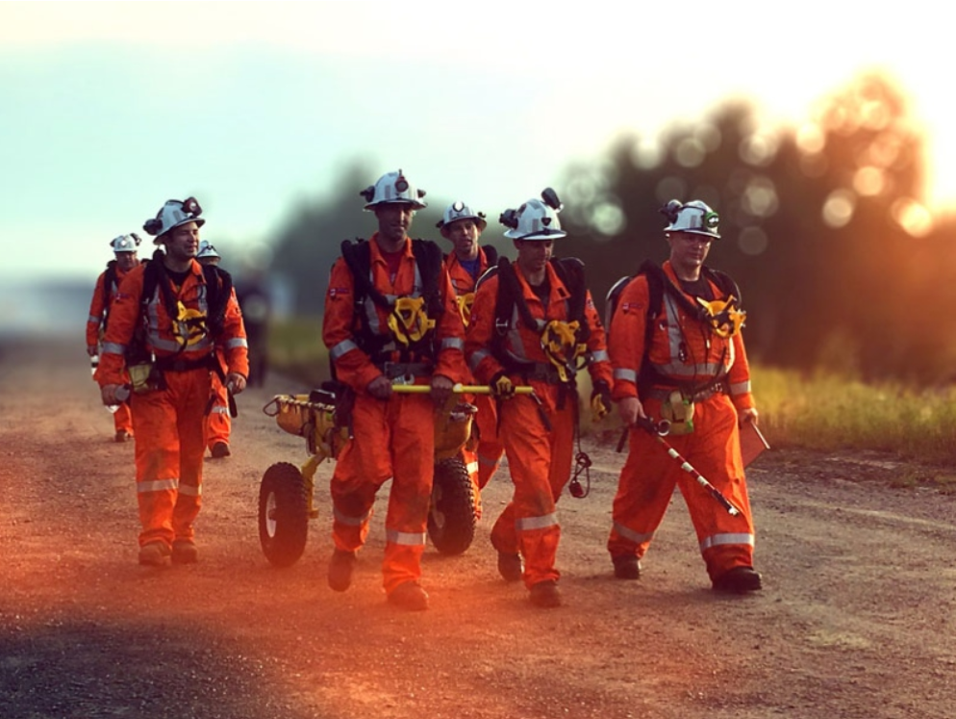
EROS
Emergency Rescue Operation System

Slide 2

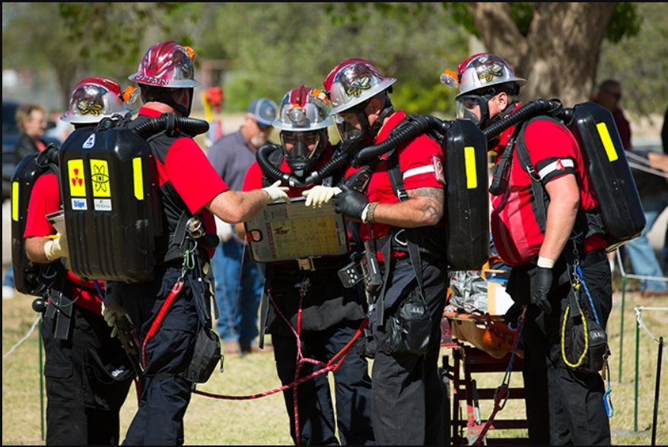
Content
Problem Statement
Solution
Important use cases
Scope

Slide 3
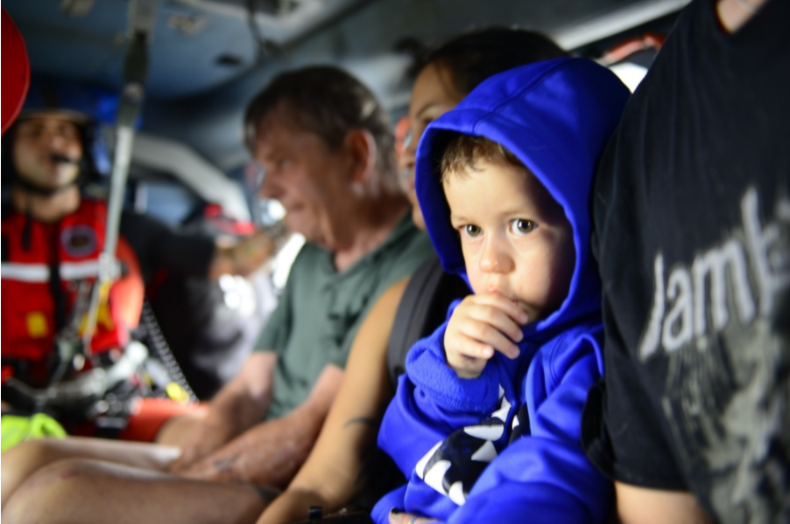
Problem Statement
Not just natural calamities, even unfortunate events such as a terrorist attack or an epidemic can claim many lives and is an emergency situation.
At the time of an emergency, it requires more than just the government organizations to rescue people and animals from the impacted area or region.
A platform is required where all the rescue operators, volunteers, donors and the medical staffs come together to carry out various operations such as, rescue, evacuation, get a clear statistics about the losses and help the impacted people and animals reach a safer place and get required medical help.

Slide 4
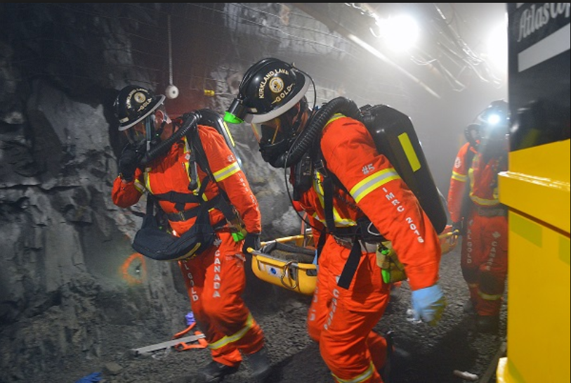
Solution
When an incident is reported, each person must be assigned a clear responsibility according to the type and severity of the emergency and right messages be broadcasted to the respected group.
Logging all activities and the required statistics of the people rescued, loss of life and kind of medical assistance needed.
Monitoring the activities of the various groups so no delay in any operation or process is encountered.

Slide 5
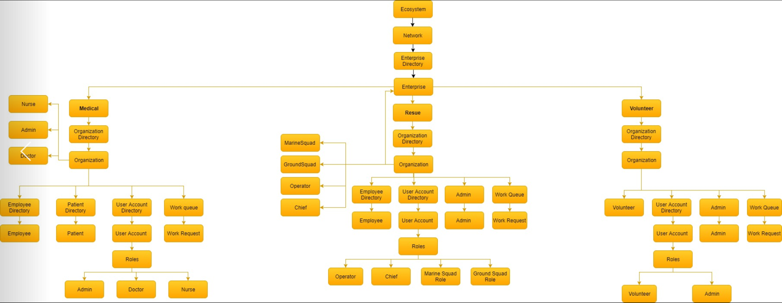
Object Model

Slide 6
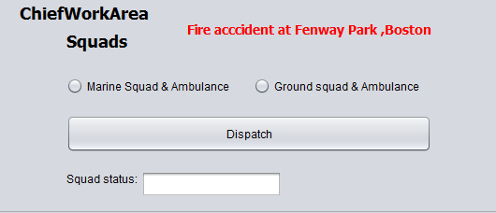
Important Use cases Operator reports an emergency in a particular enterprise of a network with the severity details to the Chief of Rescue Squad. An Alert email is sent to the people residing in the Network informing about the event and asking them to stay clear if possible.

Slide 7
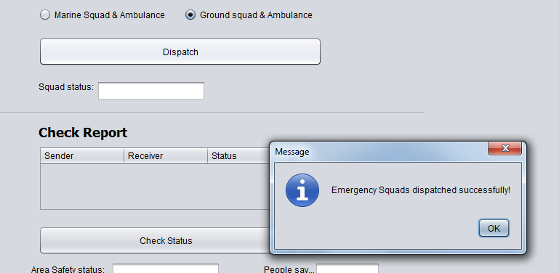
Chief will dispatch the appropriate search and rescue squads along with the emergency medical teams to the area of incident.

Slide 8
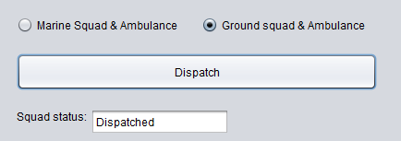
Rescue squad is always dispatched with Ambulances and EMT (Emergency Medical Technicians) for the medical evaluation and Intensive care.

Slide 9
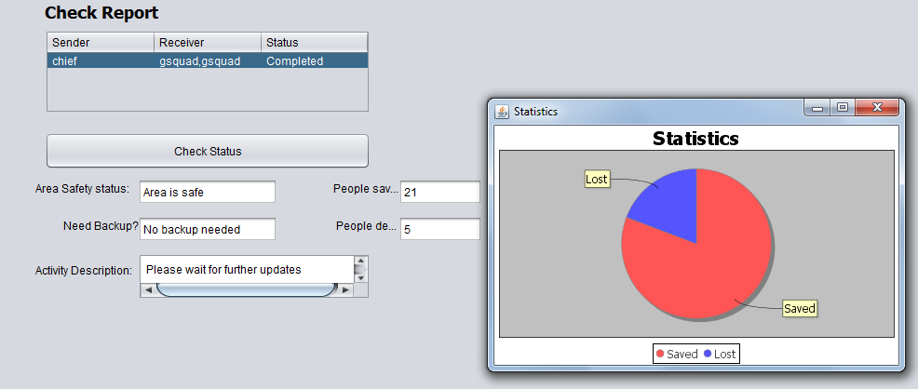
Chief analyses the reports from the Rescue squad and decides if further actions are required.

Slide 10
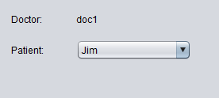
People rescued from the area of impact are then treated by doctors.

Slide 11
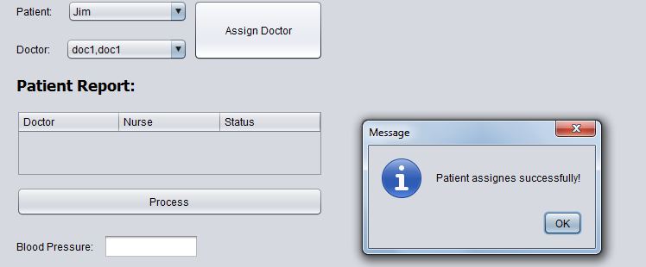
Nurse will collect patient information and assigns them to the doctor. Doctor will request for the patient’s health report and will treat the patient.

Slide 12
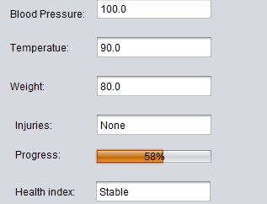
By tracking patient’s health progress, doctor will take decision if to discharge the patient or provide further treatment.

Slide 13
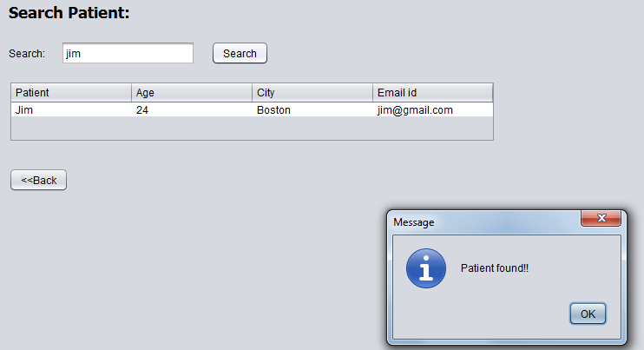
A separate log is maintained about the people who were found to be involved in the impact and families can look for them here.

Slide 14
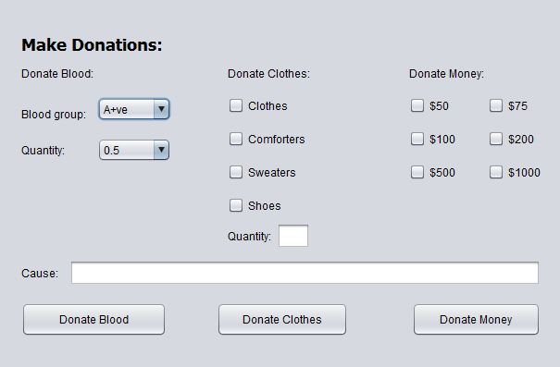
Interested volunteers can contribute to the cause in the form of donations (Blood, Financial or Clothes)

Slide 15
Thank you!

